Slide 1
Encapsulation Course Title: Programming Language II Course Code: CSE 111 Semester: Summer 2020

Slide 2
Last Lecture
Method Overloading
Constructor Overloading

Slide 3
Today’s Lecture
What is encapsulation?
Access Modifiers
Encapsulation in Python
Single Underscore(_)
Double Underscore(__)

Slide 4


Encapsulation
What’s inside?
A fundamental concept of OOP.
In OOP, encapsulation means wrapping attributes and methods that work on the attributes together in a single unit(class) and hiding it from other units.
The purpose of encapsulation is restricting the access to attributes and methods of a class to prevent the accidental modification of data.
To achieve encapsulation most OOP languages have access modifiers(Public, Private, Protected and Default).
In Python we do not have any access modifier but it can be achieved by following some conventions and name mangling.
Sales
Section
Management section
Finance
Section
A company

Slide 5
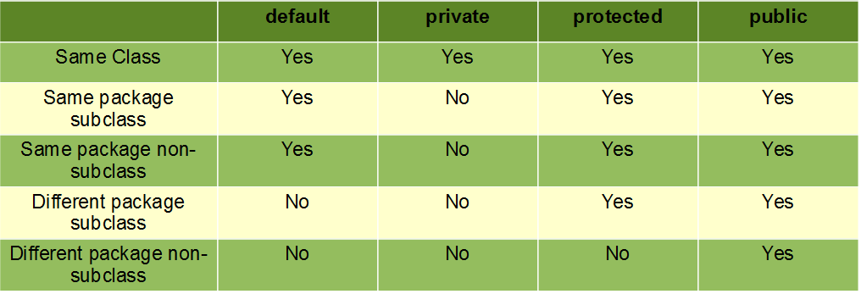
Access Modifiers
Keywords to maintain access to attributes and methods in a class.
There are 4 access modifiers in most OOP languages (Java, C++ etc.). They are:-
Public – Class members with public access modifiers are accessible from anywhere outside the class. It can be from other classes of the same package or different package as well.
Private – Class members with private access modifiers are accessible only within the class. The members cannot be accessed from outside of the class.
Protected – Class members with protected access modifiers are accessible only within the class and its subclasses.
Default – If we do not mention any access modifier( Public, Private and Protected) before a class member, it gets default access modifier. Class members with default access modifiers are accessible from anywhere(any class) inside the same package.

Slide 6
Encapsulation in Python
Python language does not have any access modifier. And there is no way to resemble the actual access modifiers exactly.
In Python any member in a class is by default public.
In order to achieve the behavior of protected access modifier python has introduced a convention of adding a single underscore (_) as prefix to a member name. Remember this is just a convention.
In order to achieve the behavior of private access modifier python has introduced name mangling(adding double underscore (__) as prefix to a member name).

Slide 7
Next Lecture
Static variables
Static methods

Slide 8


